Slide 1
COMPANY MANAGEMENT SYSTEM

Slide 2
Introduction
Who is our client?
A local fireworks company.
What problems they face?
Manual system, large records, wastage.
What is our solution?
A semi automated system.
What are the benefits?
Improved efficiency & reliability.

Slide 3
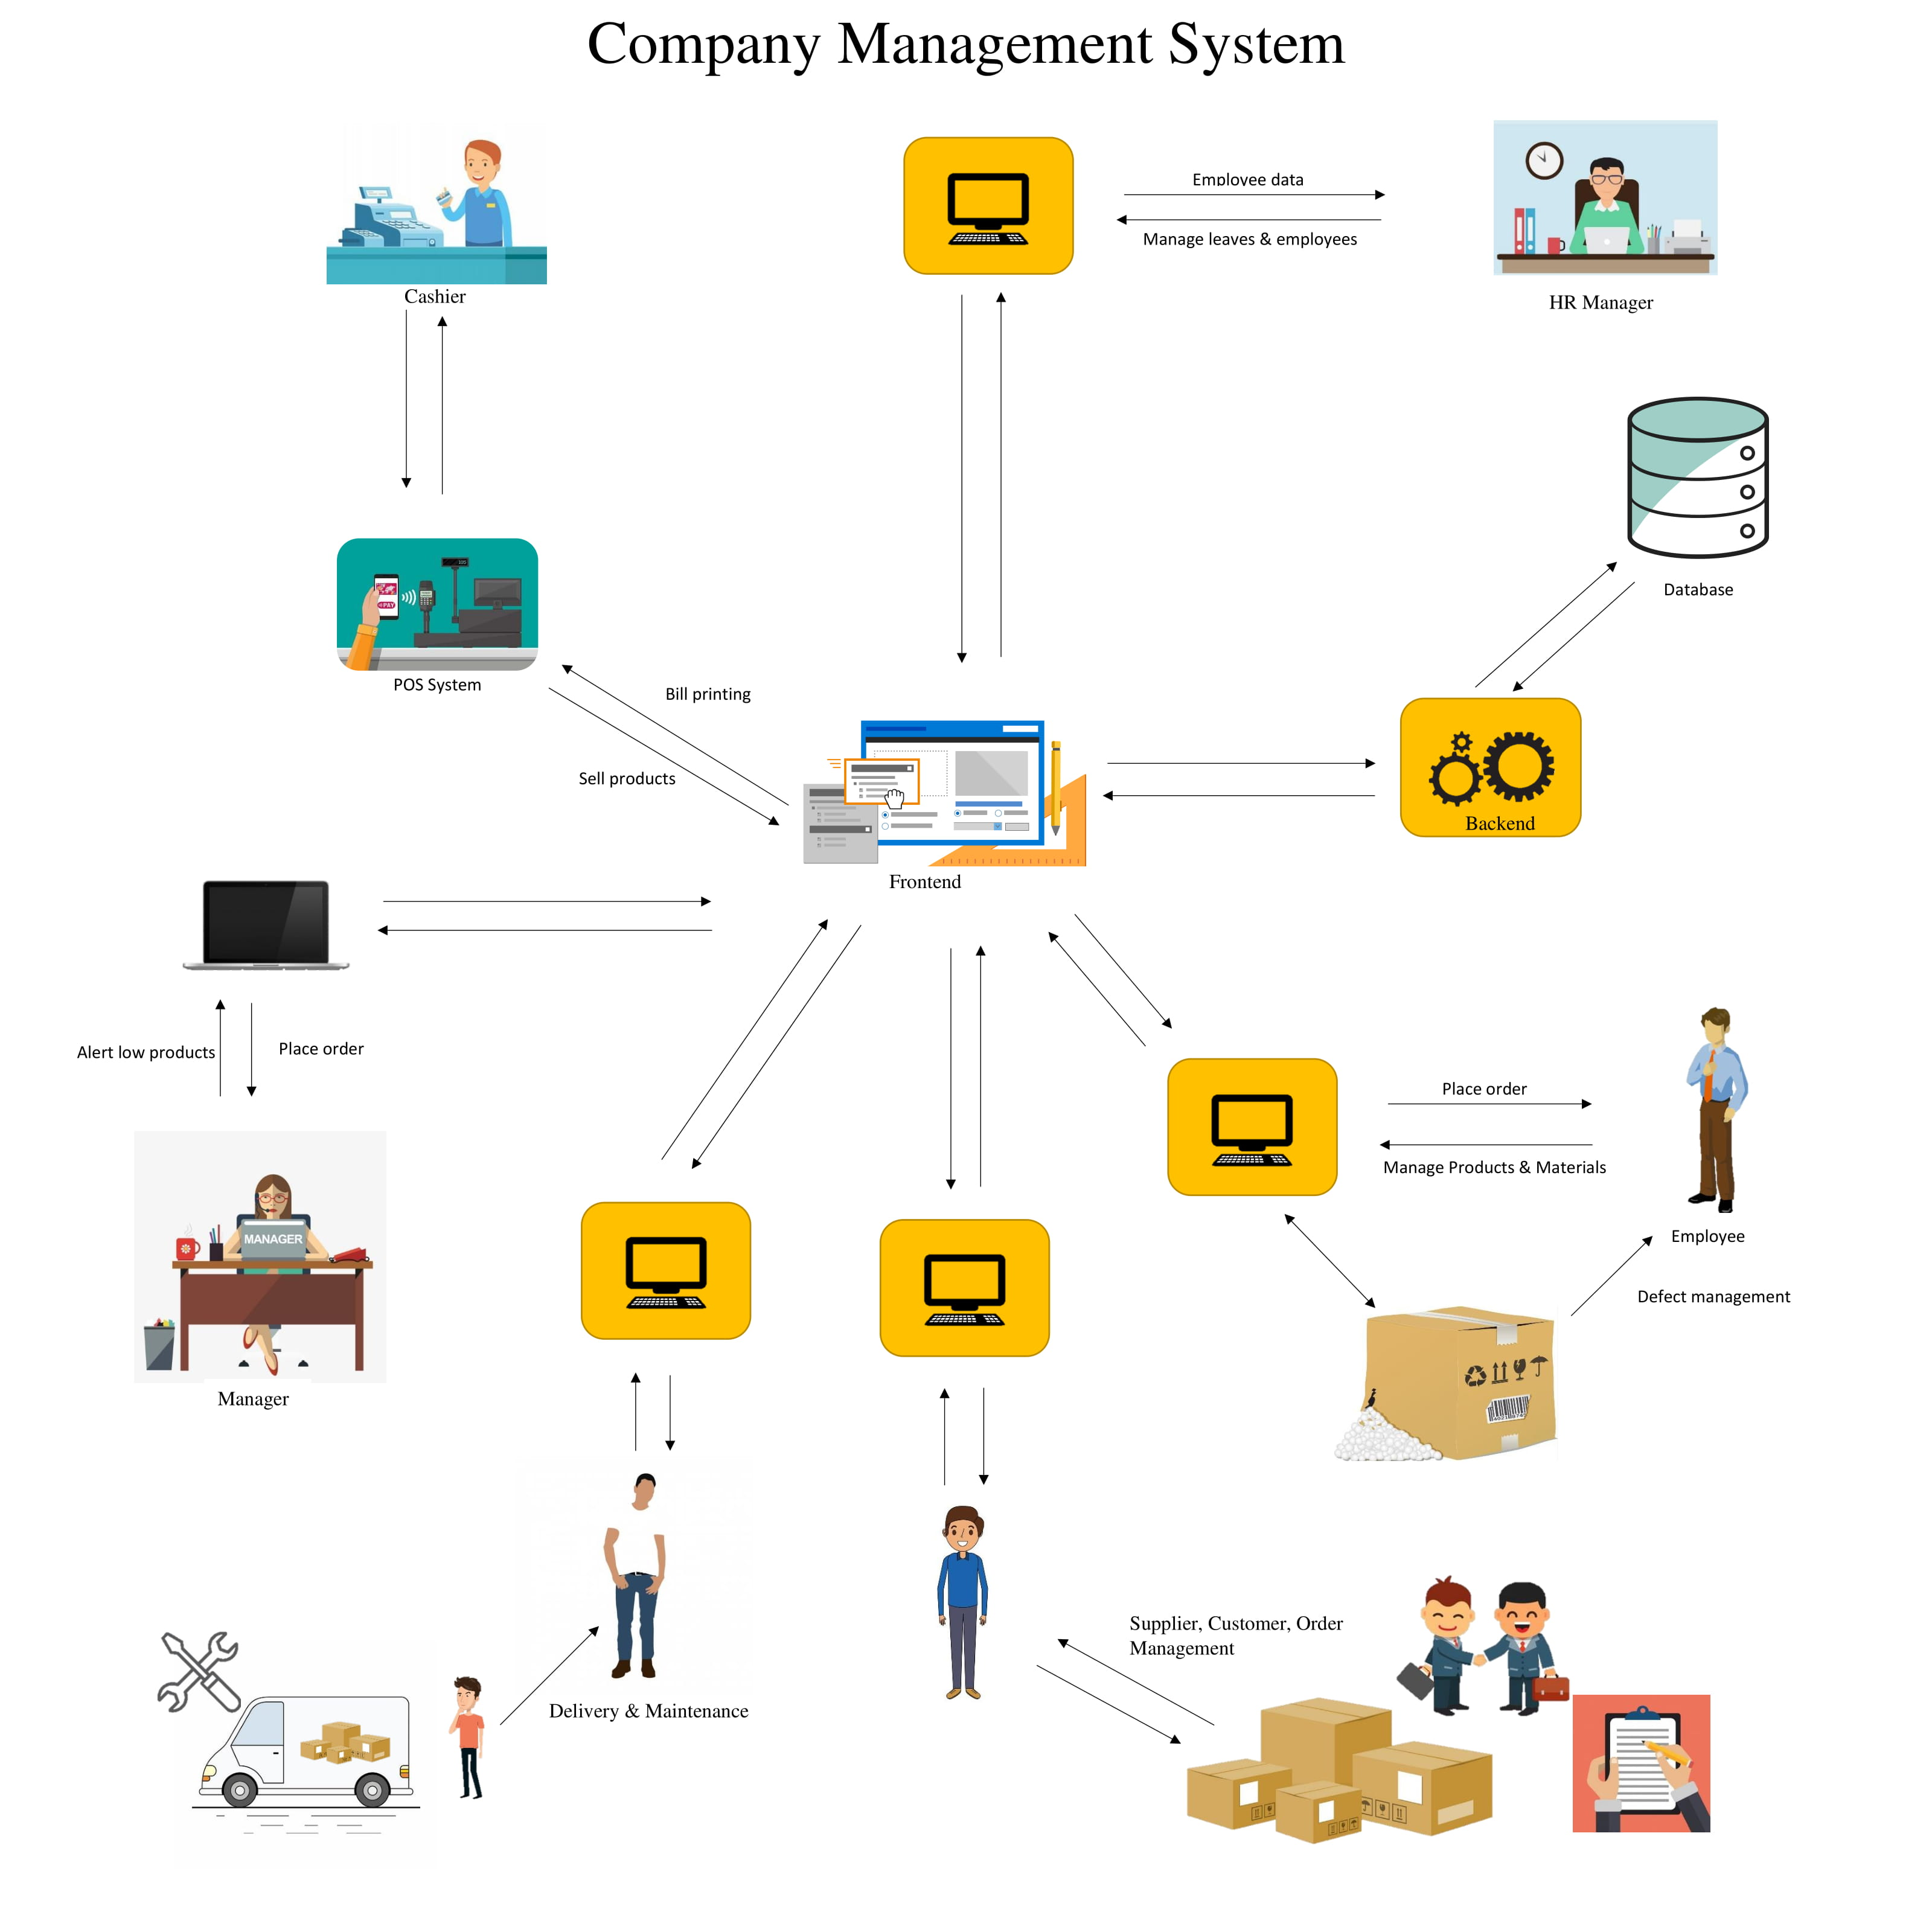

Slide 4
Raw Material Inventory
01. Add, Update, Delete Items.
Add new items, Update existing items, Delete existing items in the inventory.
05. Add, Edit, Stock.
Add new stock, Edit existing stock in the inventory.
06. Stock report.
Generate report for the stock in the inventory.
07. Alert System.
When one or more items are low on quantity system will automatically inform the user using email/SMS.

Slide 5
Product Inventory
01. Add, Edit, Remove products
Add new products, Edit existing products, Remove existing products in the inventory.
02. Product report
Generate monthly products report.
03. Defect management
Arrange a repair & remove them from the inventory.

Slide 6
Employee Management
01. Add, Edit, Delete employees
Add new employees, edit existing employees, remove existing employees.
02. Salary Management
Calculate salaries and create payout slip.
03. Salary report
Generate monthly salary report.

Slide 7
Leave & Attendance
01. Request, Approve, Reject, Update leaves
Manage employee leaves.
02. Mark attendance
Mark employee attendance daily.
03. Leave report
Generate monthly leave report.
04. Calculate EPF & ETF
Calculate EPF & ETF and deduct from monthly salary.
:
01
02
03
04
05
06
07
08
09
10
11
12
13
14
15
16
17
18
19
20
21
22
23
24
25
26
27
28
29
31
32
33
34
35
36
37
38
30
39
41
42
43
44
45
46
47
48
40
49
51
52
53
54
55
56
57
58
50
59
01
02
03
04
05
06
07
08
00
09
11
12
13
14
15
16
17
18
10
19
21
22
23
24
25
26
27
28
20
29
31
32
33
34
35
36
37
38
30
39
41
42
43
44
45
46
47
48
40
49
51
52
53
54
55
56
57
58
50
00
59
01
02

Slide 8
In Payments
01. Add, Remove, Transfer, Cheques
Manage all income cheques.
02. Billing information
Generate, Calculate bills.
03. Cheque validation
Validate and inform user about invalid or outdated cheques.
04. In payment details( income ) report
Generate monthly income report.
05. Total bill details
Generate monthly sales report.
:
01
02
03
04
05
06
07
08
09
10
11
12
13
14
15
16
17
18
19
20
21
22
23
24
25
26
27
28
29
31
32
33
34
35
36
37
38
30
39
41
42
43
44
45
46
47
48
40
49
51
52
53
54
55
56
57
58
50
59
01
02
03
04
05
06
07
08
00
09
11
12
13
14
15
16
17
18
10
19
21
22
23
24
25
26
27
28
20
29
31
32
33
34
35
36
37
38
30
39
41
42
43
44
45
46
47
48
40
49
51
52
53
54
55
56
57
58
50
00
59
01
02

Slide 9
Out Payments
01. Request, Approve, Update, Reject payment
Manage out payments of the company.
02. Cheque handling for payments.
Manage the expenses using cheques and due dates.
03. Generate monthly payment report.
Generate monthly expense report for the company.

Slide 10
Delivery & Maintenance
01. Manage vehicles
Insert, Update, Delete vehicles & maintain.
02. Calculate product delivery
Calculate daily delivery sales.
03. Maintain services
Maintain vehicles & others.
04. Delivery report
Generate monthly delivery report.

Slide 11
Supplier, Customer & Orders
01. Add, Update, Remove suppliers
Manage suppliers.
02. Manage customers
Add, Update, Remove customers.
03. Manage orders
Add, Update, Remove orders.
04. Customer loyalty service
Apply special discounts for permanent customers.
05. General Report
Generate monthly reports for orders.

Slide 12



DEVELOPMENT ENVIRONMENT
MYSQL Database Management System
Microsoft .NET framework
C# Windows forms apps
Microsoft Visual Studio 2017 Community edition

Slide 13

Work breakdown chart
 | IT number | Name | Function
01 | IT17181402 | D. G. Y. C. K. Alwis | Raw material inventory
02 | IT17182188 | R. M. M. G. Rathnayake | Product inventory
03 | IT17267632 | A. S. De Zoyza | Out Payments
04 | IT17187206 | H. M. H. G. B. Amarasinghe | Supplier, Customer & Order management
05 | IT17142960 | P. K. S. L. C. Gamage | Leave and attendance
06 | IT17370974 | K. A. R. N. Aththanayake | Employee management
07 | IT17183628 | K. W. H. M. R. I. B. Abeykoon | In Payments
08 | IT17184090 | G. R. N. M. Bandara | Delivery and maintenance

Slide 14
THANK YOU!

